Slide 1
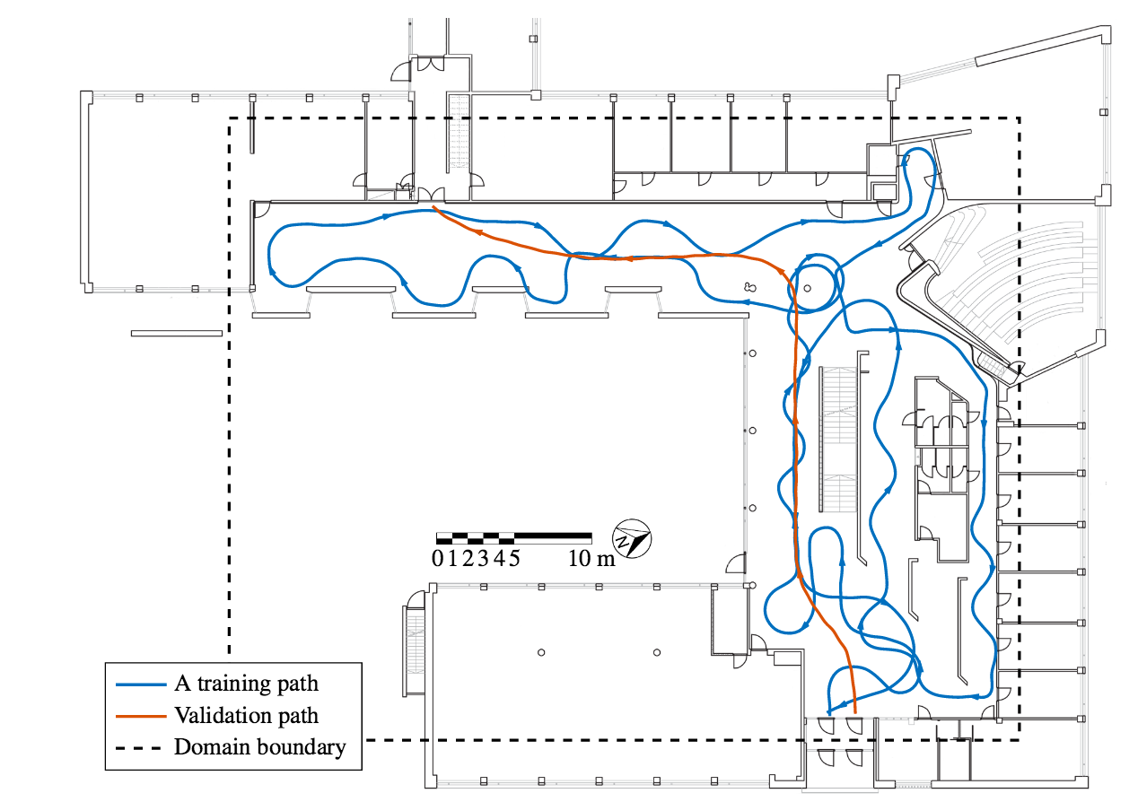


Slide 2
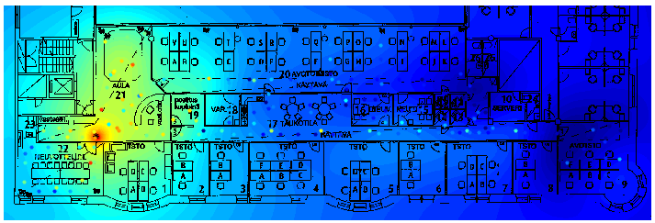
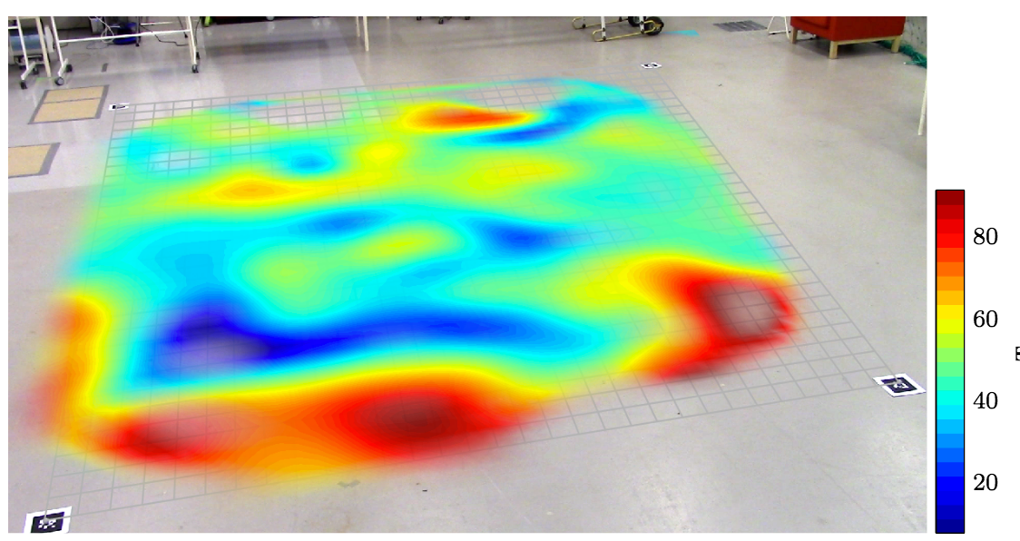

Slide 3

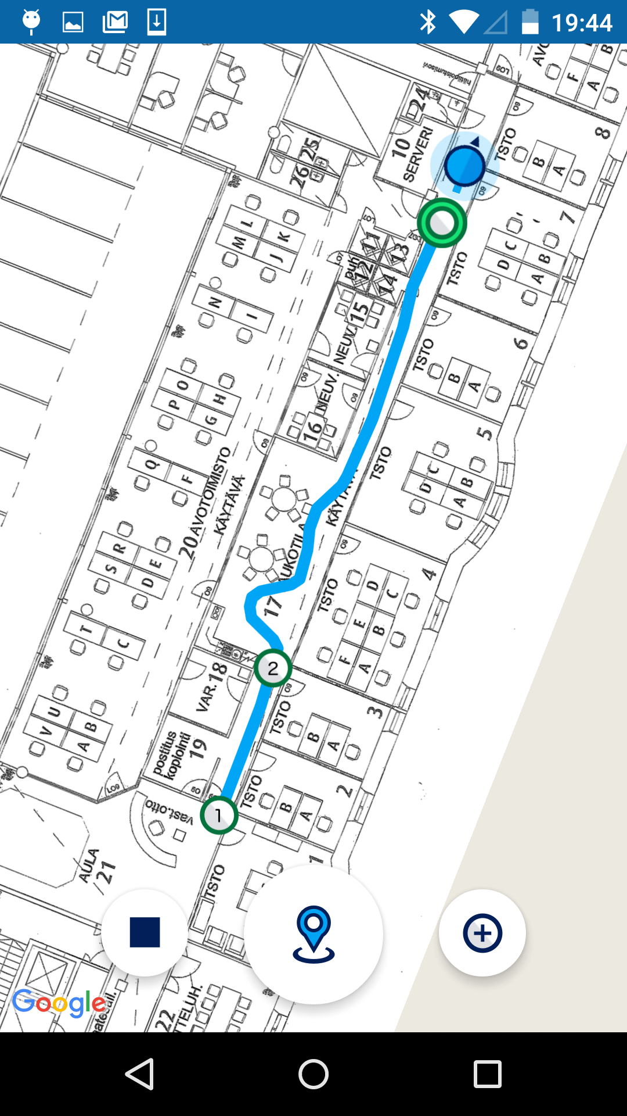

Slide 4


Slide 5
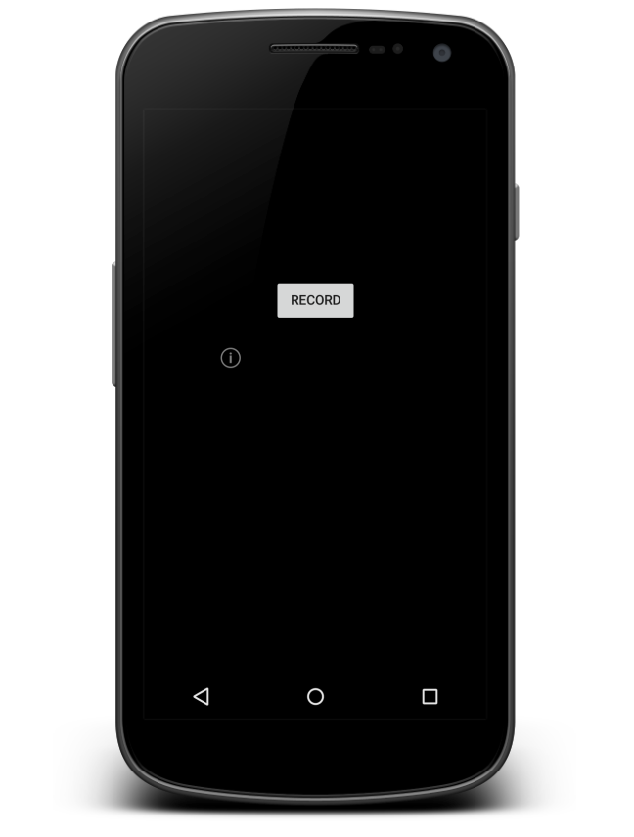
GPS/GNSS
Accelerometer
Gyroscope
Wi-Fi
Bluetooth
3G/4G/5G
Magnetometer
Barometer

Slide 6
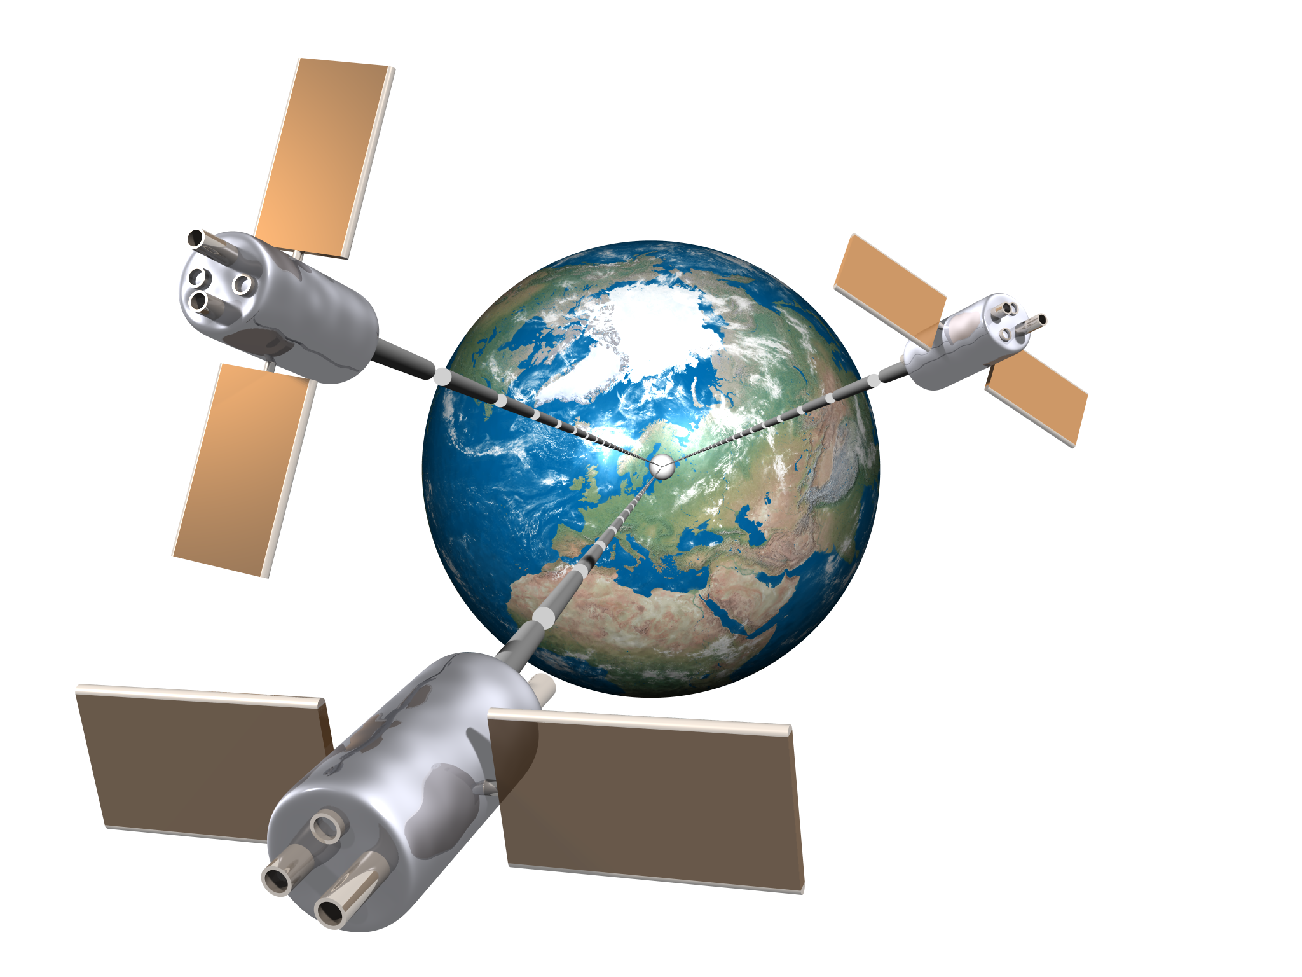

Slide 7
Are we here?
… or here?
2 meters

Slide 8
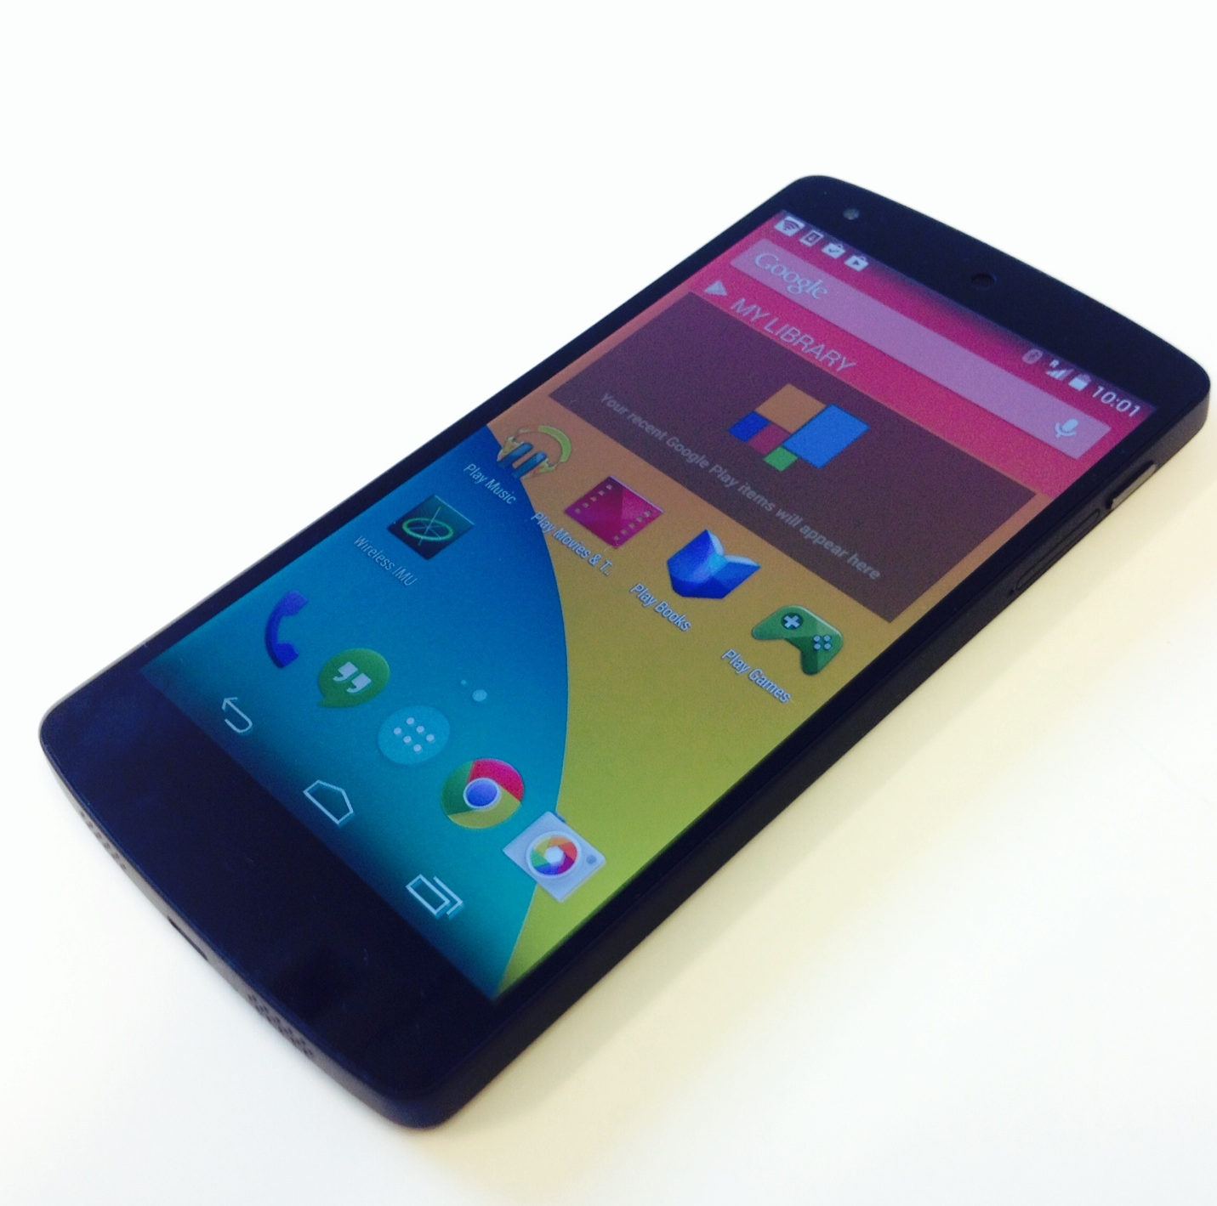
Floor 3
?
Floor 2
Floor 1

Slide 9
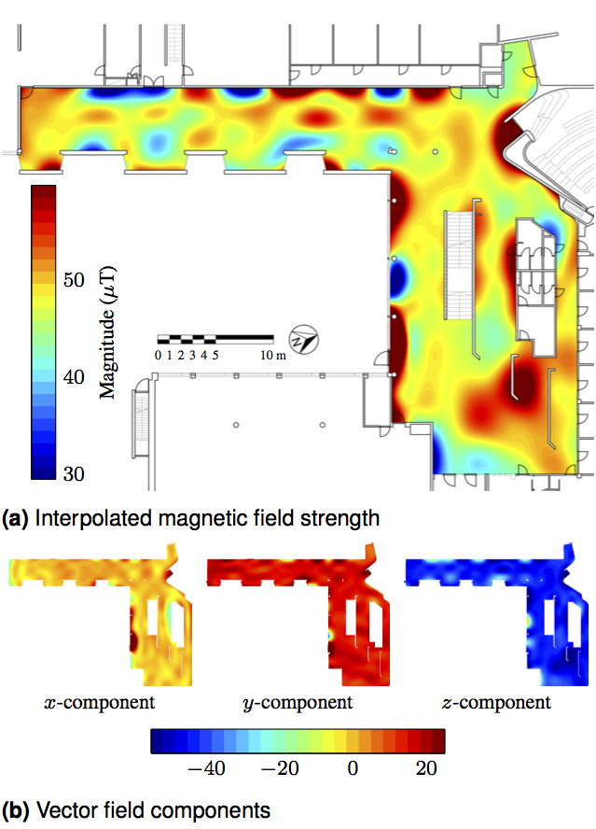

Slide 10
